Slide 1
BDD: behavior driven testing
45426: Teste e Qualidade de Software
Ilídio Oliveira
v2024-03-12

Slide 2
Learning objectives
Explain how “features/user-stories” are used as a conversation tool to build functional specifications
Write simple acceptance criteria for a user story in structured text
Write acceptance scenarios using the Gerking language
Describe the steps to implement BDD in Java using the Cucumber framework

Slide 3
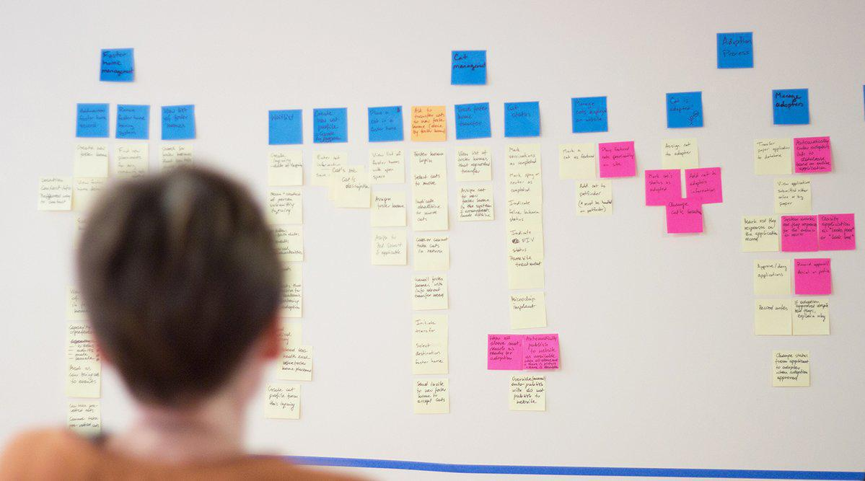
A metáfora do “post-it”
Granularidade adequada para distribuir o trabalho
Rastreabilidade para os requisitos (cenários de uso)
Alguns “post-it” por iteração

Slide 4
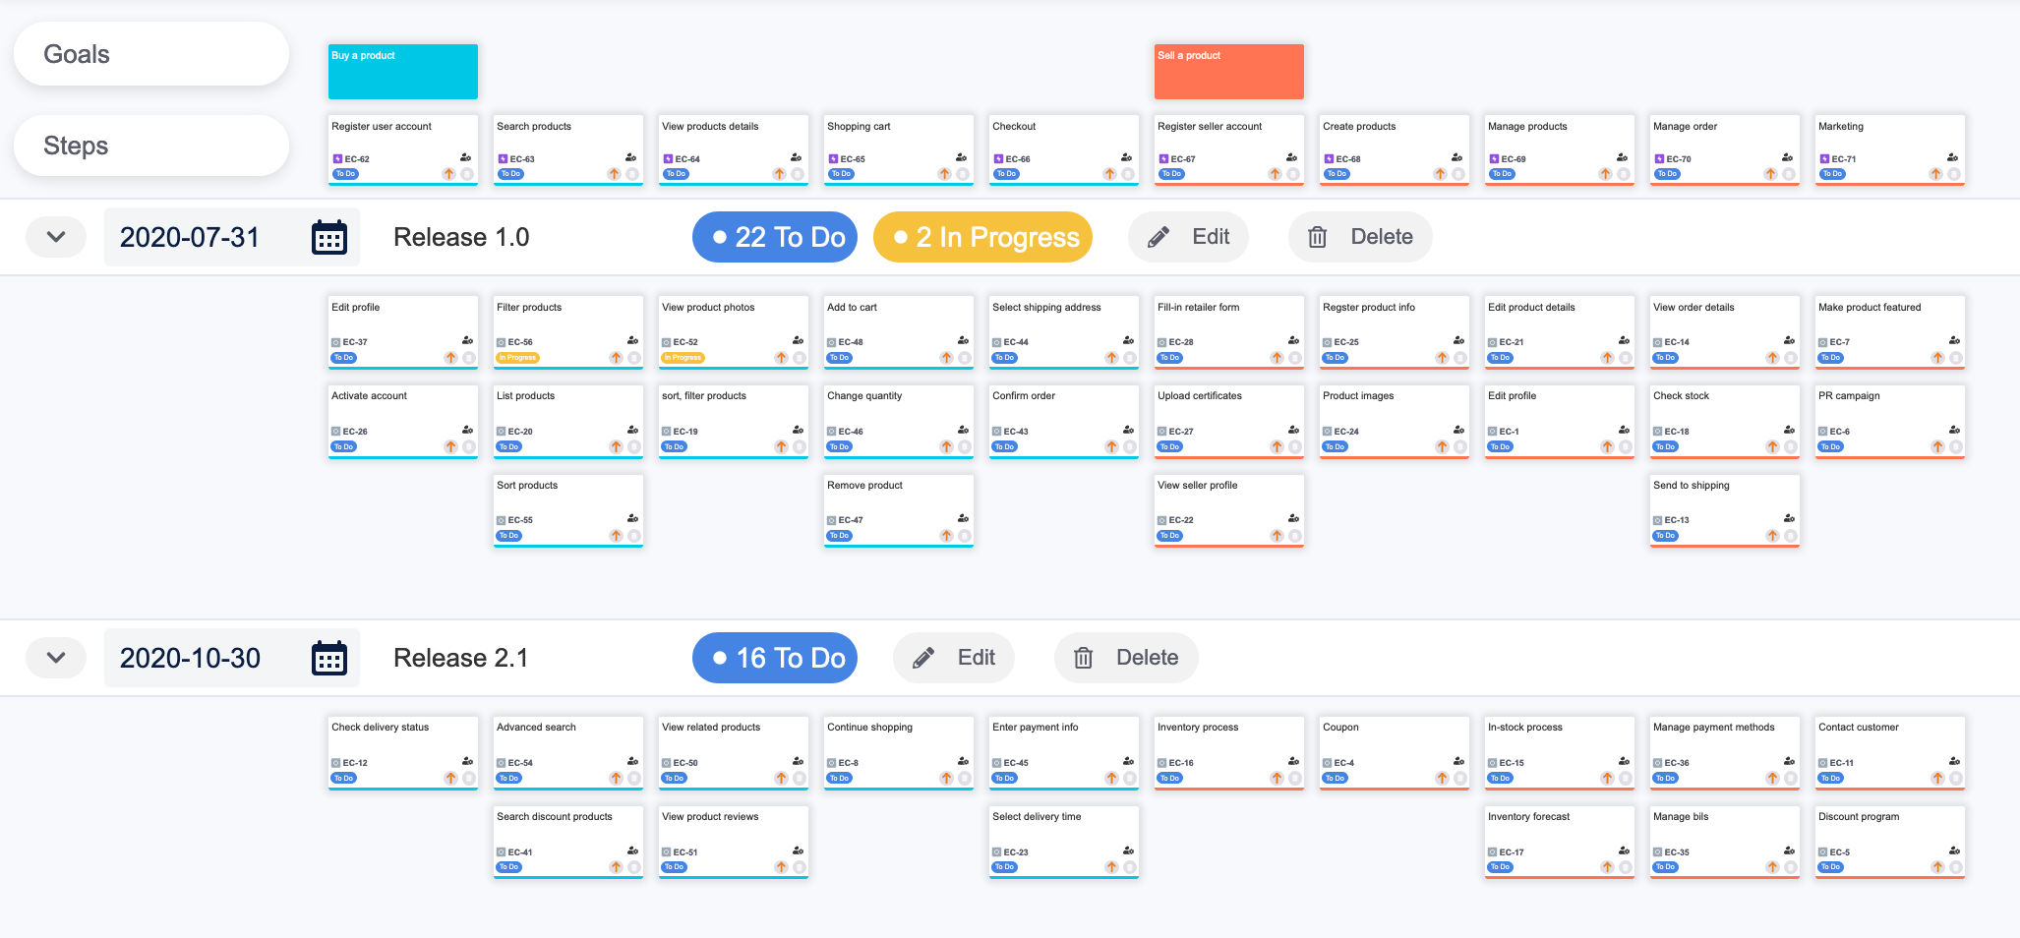

https://www.devsamurai.com/en/agile-user-story-mapping-for-jira/

Slide 5
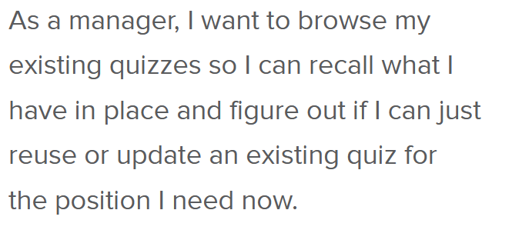
User stories: behavior by example
→ some examples

Slide 6
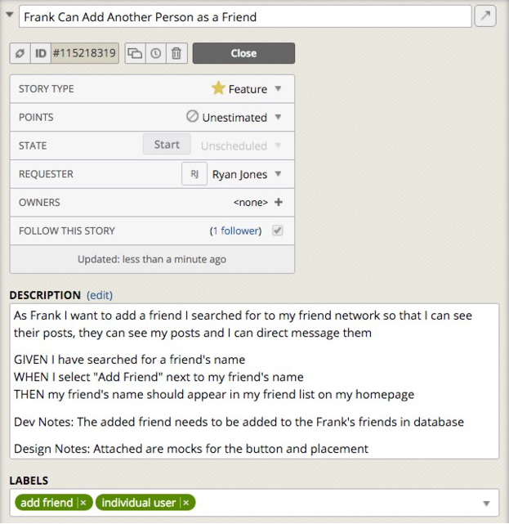
Stories and scenarios
(User) Story as the basic unit of functionality, and therefore of delivery.
Captures a feature of the system
defines the scope of the feature and its acceptance criteria.
They are also used as the basis for estimation when we come to do our planning
Can be mapped on outcomes, requirements
https://www.pivotaltracker.com/blog/principles-of-effective-story-writing-the-pivotal-labs-way
What's in a Story?
http://dannorth.net/whats-in-a-story/
Notes:
A way for telling that the story is acceptably implemented
May have still low-level defects in the code
It'll be doing what the programmers intend it to
It'll be doing what it is supposed to be doing

Slide 7
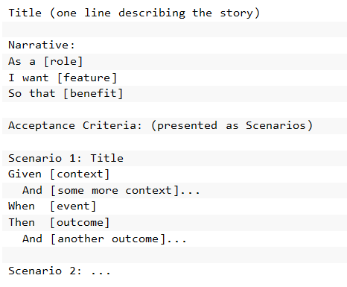
Stories and testing...
Can we write the acceptance criteria in a way that it is executable?

Slide 8
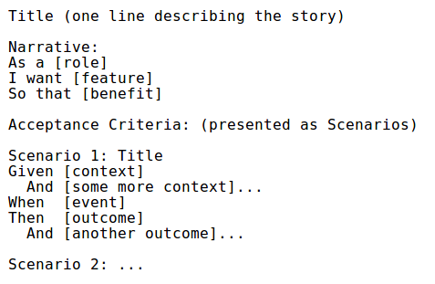
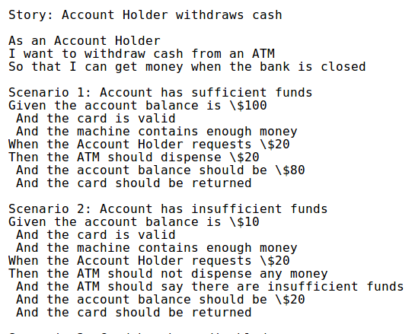








Story: the scope of a feature + its acceptance criteria.
Functional view.
Value for the user.
Specification by examples.
Credit: http://dannorth.net/whats-in-a-story/

Slide 9
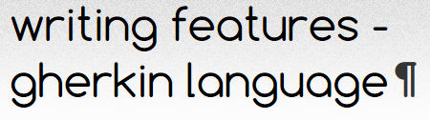
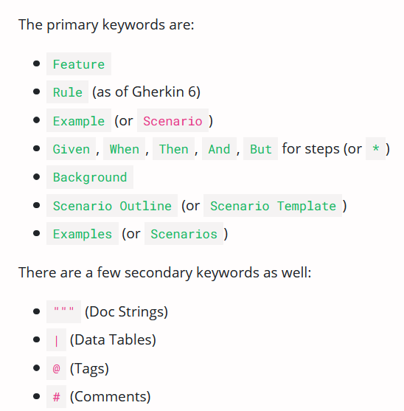
Features are described in the Gherkin Language (DSL)
Gherkin to describe a feature (for testing):
Feature: what
Scenario: some determinable business situation
Given: preparation/setup (e.g.: required data)
And…
When: the set of actions (execute).
And…
Then: specifies the expected resulting state (assert).
And…
→ Sample

Slide 10
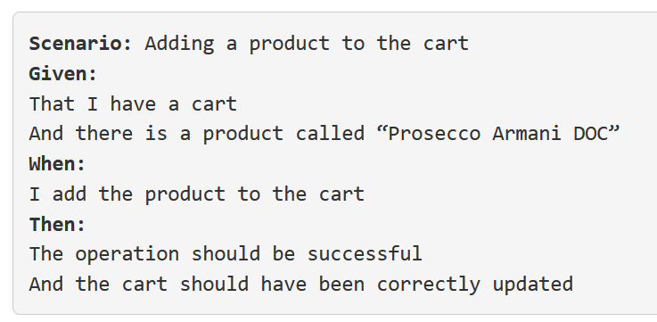
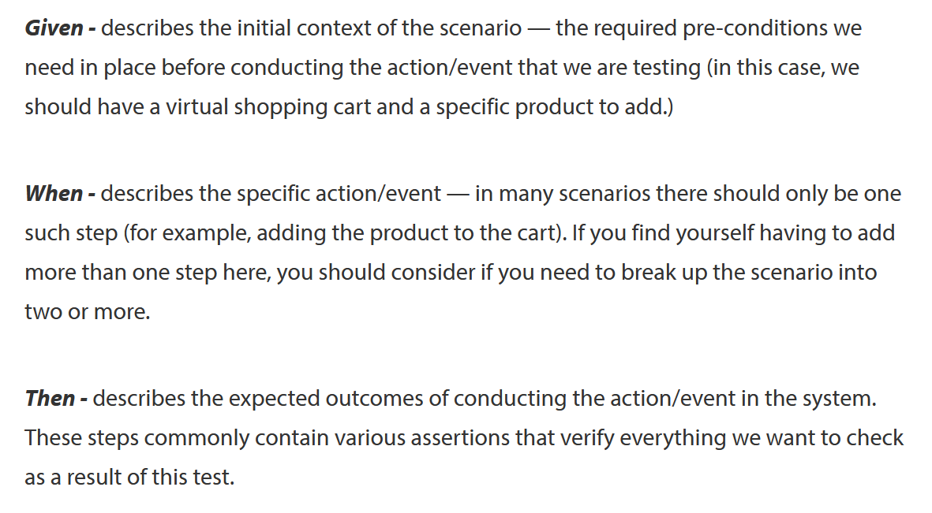

Slide 11
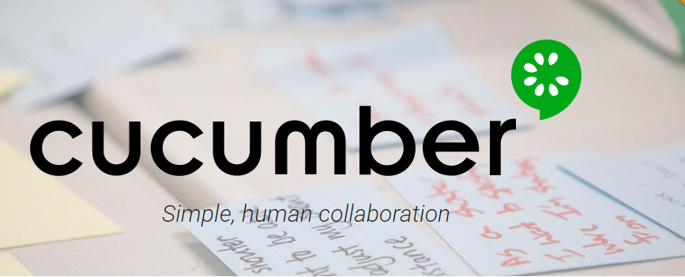
Cucumber framework for tests
Goal
common understanding of the problem ⇒ simplify the communication between all parties
Cucumber way
express requirements using concrete examples (Gherkin syntax)
create examples of behavior that are executable
examples are found in a collaborative way (business analysts, testers and developers)
examples can be used as acceptance tests (with additional preparation steps)

Slide 12
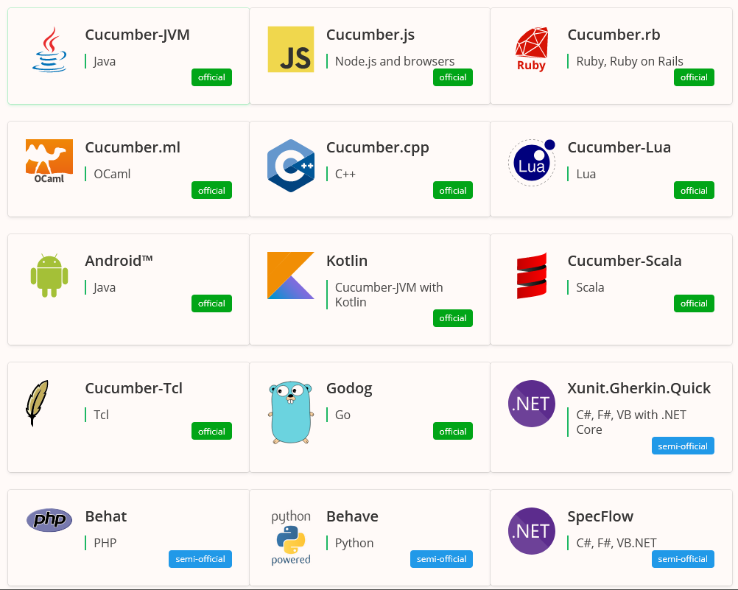
The same approach, many frameworks
https://cucumber.io/docs/installation/

Slide 13
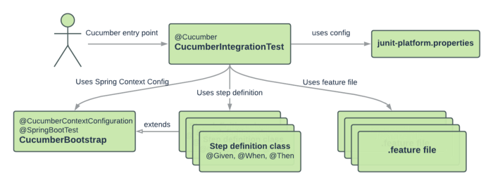
Test elements (example)
Note: For Cucumber JUnit 5, feature files need to be located under the same package structure as their corresponding step definition’s steps package
@Cucumber is now deprecated…
This example uses Spring Boot. Not required though.

Slide 14
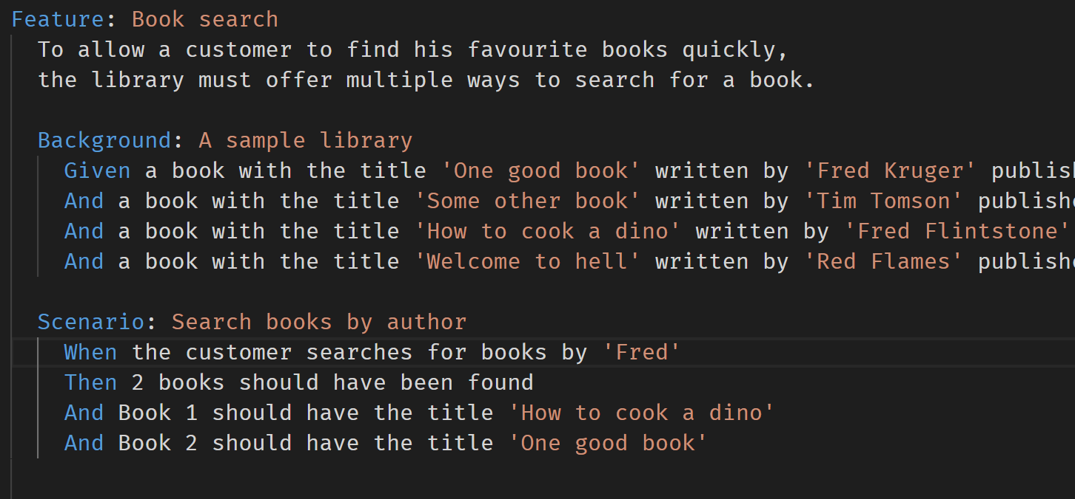
.feature

Slide 15
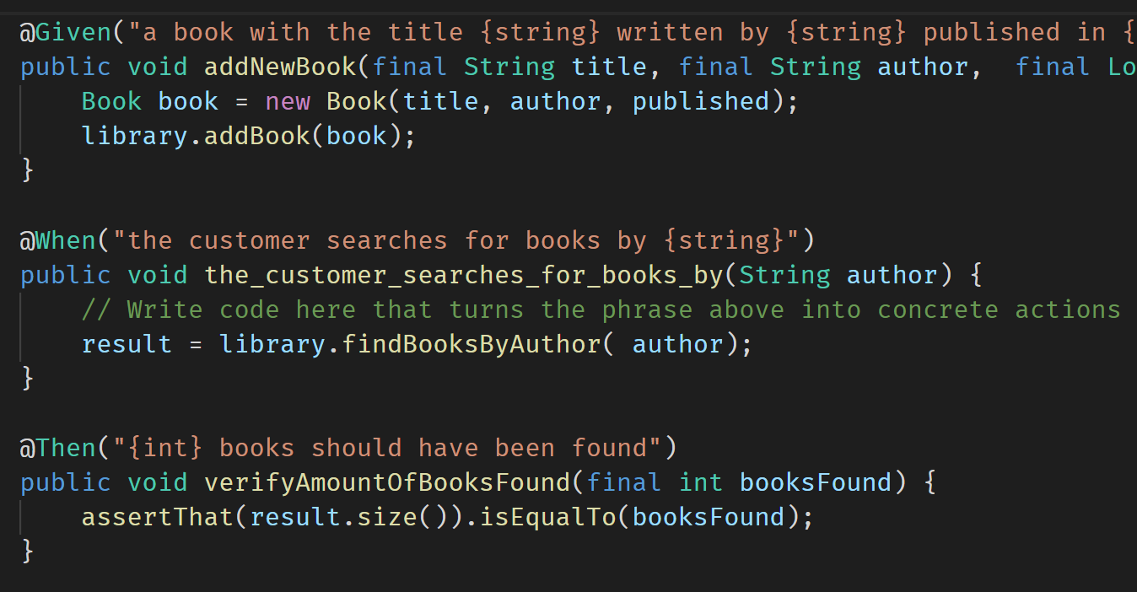
steps mapping
The steps in the feature are mapped to test methods, using annotations.

Slide 16
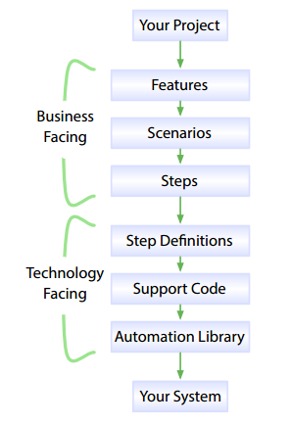
Cucumber reads specifications from plain-language text files called features, examines them for scenarios to test.
Each scenario is a list of steps for Cucumber to work through.
Along with the features, you give Cucumber a set of step definitions, which map the business-readable language of each step into code to carry out whatever action is being described by the step.
The step definition itself will probably just be one or two lines of code that delegate to a library of support code, specific to the domain of your application.
Sometimes that may involve using an automation library, like the browser automation library Selenium.

Slide 17
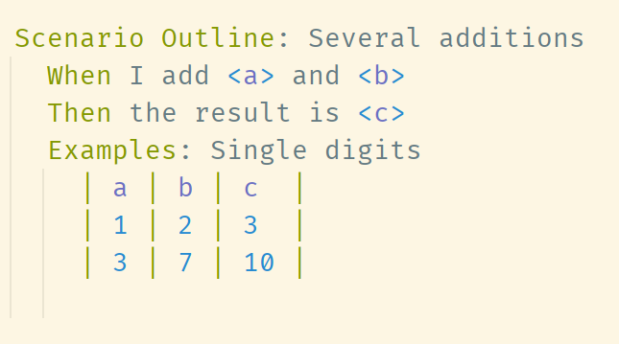
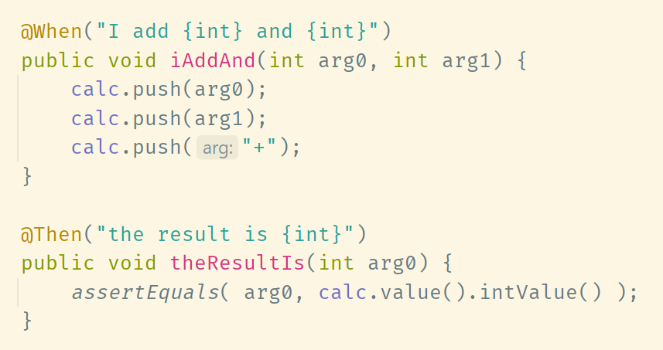
Helpful format: define an outline to be run against a few examples.

Slide 18
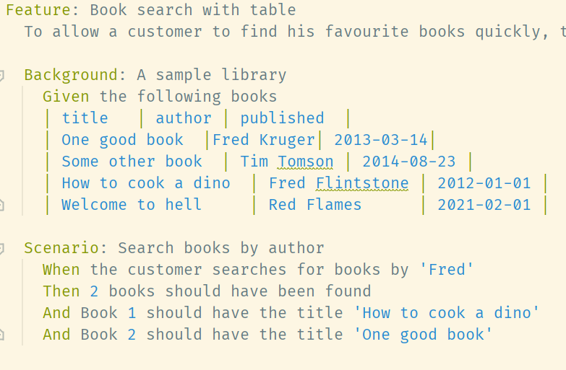
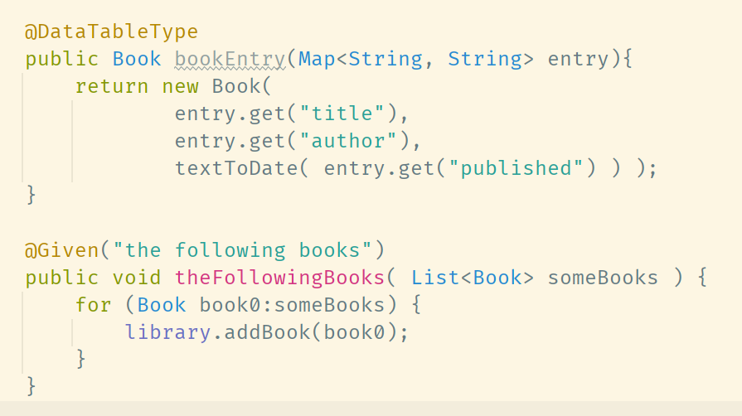
Specifications can include data as tables to feed the tests.

Slide 19
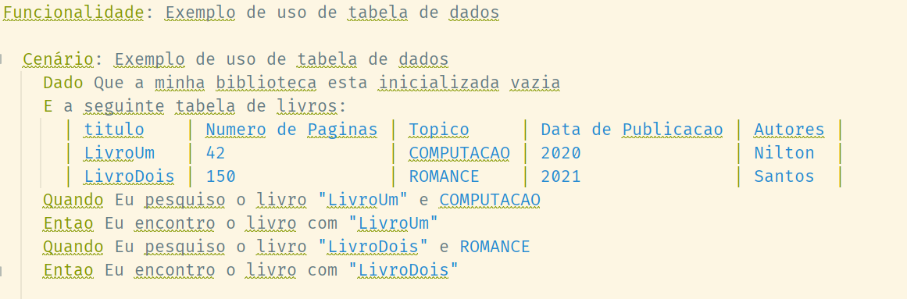
https://cucumber.io/docs/gherkin/languages/
Keywords available in different languages (localization)

Slide 20
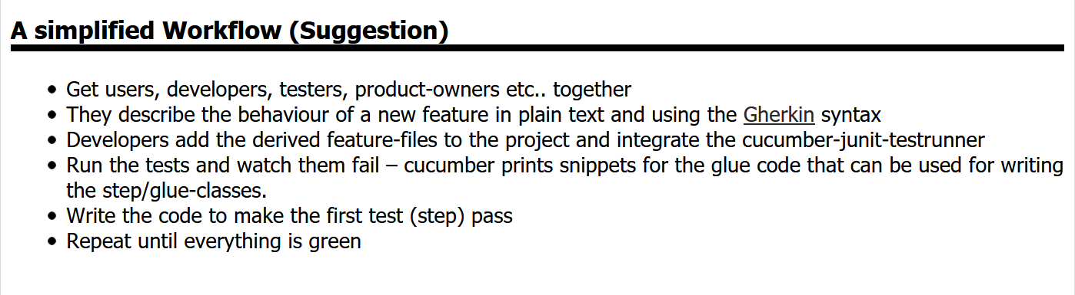
BDD as a work process

Slide 21
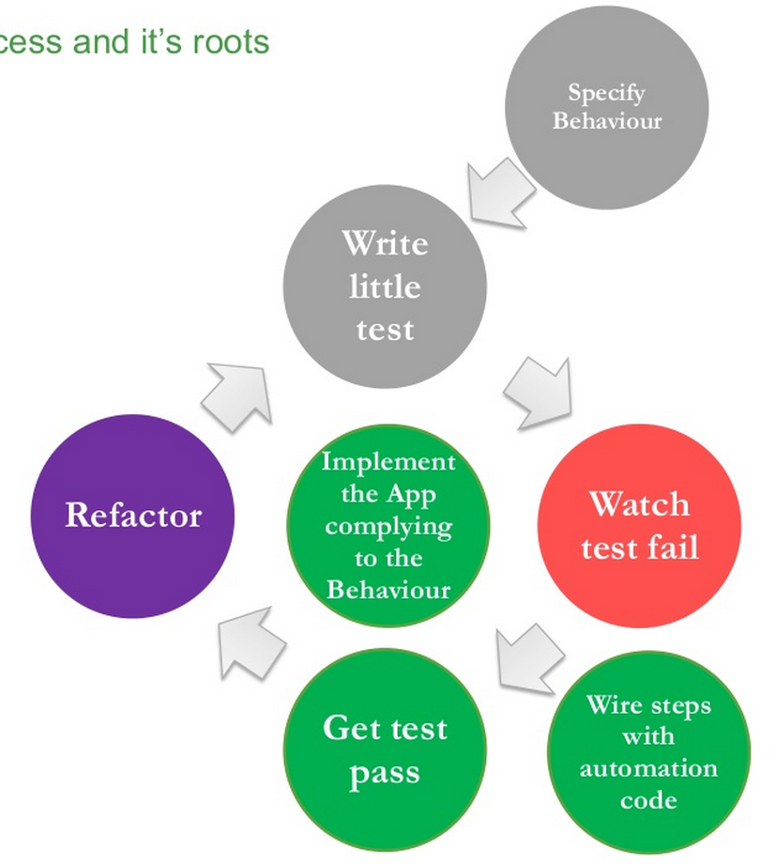
BDD: Behaviour-driven
development
Credit: Nalin Goonawardana

Slide 22
Views from Robert C. Martin
BDD is a variation on TDD.
Whereas in TDD we drive the development of a module by “first” stating the requirements as unit tests, in BDD we drive that development by first stating the requirements as requirements.
The form of those requirements is fairly rigid, allowing them to be interpreted by a tool that can execute them in a manner that is similar to unit tests.
https://sites.google.com/site/unclebobconsultingllc/the-truth-about-bdd

Slide 23
BDD vs TDD (xUnit Level)
BDD
TDD + Unit testing
Top-down
Human readable
Sharable to all the team
Business-facing
Tangible requirements.
Bottom-up
Programming language
☹
Developer-facing
Module contracts.

Slide 24
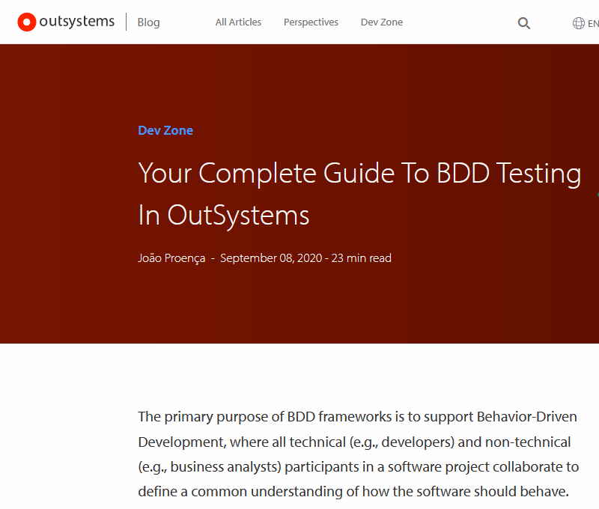
https://www.outsystems.com/blog/posts/bdd-testing/

Slide 25
Resources and readings
Sundberd, T., “Where should you use Behaviour Driven Development, BDD?”
https://smartbear.com/learn/automated-testing/is-bdd-right-for-you/
Kops, “BDD Testing with Cucumber, Java and Junit”

